Slide 1
The 1970’s
Developing a variety of Rock and Roll styles

Slide 2
Bruno Mars

Slide 3
What’s happening in the US in the 1970s?
Americans are active in protesting against the Vietnam War - in May of 1970, a protest at Kent State University gets out of hand and the National Guard who were there to keep the peace shot and killed 4 students
1970 - American Top 40 (hosted by Casey Kasem) becomes the first nationally syndicated radio program with a weekly countdown
1970 - PBS starts broadcasting
1971 - A ban on cigarette ads on radio and television is implemented in the US
1972 - Watergate Scandal - 5 men are arrested for burglary at the DNC headquarters in the Watergate Office Complex in Washington, DC

Slide 4
1972 - US Presidential Election - Nixon is re-elected
1972 - Apollo 17 flies to the moon, becomes the last manned mission there
1973 - Senate Watergate hearings begin - secret tapes found that incriminate Nixon as part of the robbery
1974 - House Judiciary Committee votes to impeach Nixon but he resigns. VP Gerald Ford becomes President - he later pardons Nixon for his role in the scandal
1974 - Hank Aaron of the Atlanta Braves breaks Babe Ruth’s HR record
1975 - Bill Gates founds Microsoft
1975 - Wheel of Fortune and Saturday Night Live premiere on NBC
1976 - The US celebrates the country’s bicentennial

Slide 5
1977 - Elvis Presley, the king of rock and roll dies at the age of 42. 75,000 fans line the streets of Memphis for his funeral.
1977 - Atari 2600 becomes the first successful home video game system
1979 - 3 Mile Island nuclear accident on 3 Mile Island in the Susquehanna River in Harrisburg, Pennsylvania
1979 - Iran Hostage Crisis - 52 American diplomats and citizens were held hostage for over 400 days after a group of students took over the US Embassy in Tehran - subject of the movie Argo
1979 - American Airlines flight 191 crashes after takeoff from O’Hare International Airport, killing all passengers and 2 on the ground - deadliest aviation incident on US soil until 9/11/2001

Slide 6
1970s Music
July 1973 - Watkins Glenn Summer Jam at Watkins Glen Speedway in Watkins Glenn, NY
Thought of as a “let down” musically after Woodstock. Many of the “greats” were dead by this point
“27 Club” - group of popular musicians & performers who died at age 27, often due to drug and alcohol abuse. Included: Brian Jones, Jimi Hendrix, Janis Joplin and Jim Morrison between 1969-71 (drug related) and also Kurt Cobain (suicide) in 1994 among others
At this point, rock has been around for 20 years and had reinvented itself many times. Rock splinters into many different “sub-genres” in the 1970s

Slide 7
Singer-Songwriter
Considered the “great pop movement of the 70s”
Singer-songwriter changes the idea of rock from a full band to a single artist: “We” becomes “Me”
Singer-songwriters write, compose and perform their own music including lyrics AND melodies - they often provide the only accompaniment to their singing, generally on guitar or piano
Many early singer-songwriters used their music for political protest. This idea came back in the 60s and 70s to help protest the Vietnam War
Important artists in this genre: Carole King, James Taylor, Van Morrison, Jackson Brown, Neil Young, Bruce Springsteen, Harry Chapin, Neil Diamond and Jimmy Buffett

Slide 8
Carole King
Career began in the 60s when she and her husband wrote more than two dozen hits for other artists. The two were inducted into the Rock and Roll Hall of Fame in 1990
Debut album Writer flopped; 2nd album Tapestry was a huge hit and was #1 on the US Album Chart for 15 weeks and remained on the chart for more than 6 years
Released 25 solo albums and collaborated frequently with James Taylor
Won a Grammy Award and has a star on the Hollywood Walk of Fame

Slide 9
Carole King -
“I Feel the Earth Move”

Slide 10
James Taylor
1970 - JT has his first song hit the charts at #3 - “Fire and Rain”
1971 - First #1 hit - “You’ve Got a Friend” - a Carole King song
From Boston, MA - plays frequently in the area - Tanglewood Music Festival in Lee, MA; has played at Red Sox games, most recently at the game after the marathon bombing in 2013.
Sweet Baby James album was #103 on Rolling Stone’s “500 Greatest Albums of All Time” (2003)
Won 5 Grammy Awards, including “Best Pop Vocal Performance, Male” for “You’ve Got a Friend” (1971)
2001 - Inducted into the Rock and Roll Hall of Fame and has released 16 solo albums, most recently Covers in 2008

Slide 11
James Taylor -
“Fire and Rain”

Slide 12
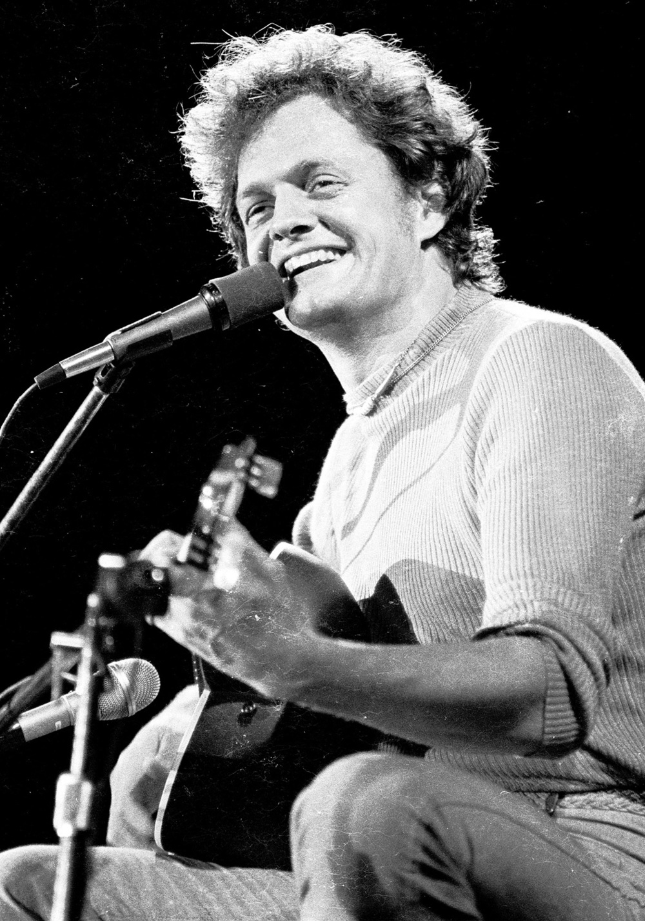
Harry Chapin
Harry Chapin is considered a singer-songwriter and a folk musician. He played guitar, piano and harmonica as well as sang his own music
Chapin started his career playing in a band with his brothers, with their father occasionally playing drums for them. The brothers put out an unsuccessful album before Harry started his solo career
Harry is best known for his songs: “Taxi”, “Sniper”, “Flowers are Red”, and his #1 hit - “Cats in the Cradle”
Harry was a dedicated humanitarian and donated most of his earnings from shows and album sales to ending world hunger
1981 - Harry suffered a heart attack while driving to a show and swerved in front of a tractor trailer, which hit his car and caused it to burst into flames. He was unable to be resuscitated at the hospital and passed away.
1987 - Posthumously awarded the Congressional Gold Medal for his humanitarian efforts

Slide 13
Harry Chapin -
“Cats in the Cradle”

Slide 14
Southern Rock
This sub-genre of rock was created in the Southern US and contains elements of blues, jazz, soul, R&B and Rock and Roll
Principal architects of Southern Rock included the Allman Brothers Band. They helped advance rock as a medium for improv (along with The Grateful Dead & Cream).
Their type of “jamming” required lots of technical skill & musical literacy that was new to Rock and Roll
Other important bands for Southern Rock: Lynyrd Skynyrd, Molly Hatchet, The Doobie Bros., Charlie Daniels Band and The Marshall Tucker Band

Slide 15
Allman Brothers Band
1969 - band is formed. Includes the following original members: Duane Allman (guitar), Gregg Allman (vocals, organ), Dickey Betts (guitar, vocals), Berry Oakley (bass), Butch Trucks (drums) and Jai Johanny Johanson (drums)
1971 - release live album At Fillmore East. This album is their breakthrough album
1971 - a few months after the release of At Fillmore East, Duane Allman was killed in a motorcycle accident
1972 - Berry Oakley dies, also from a motorcycle accident
The band continued playing until 1976, took a 2 year hiatus and then started playing again from 1978-1982, took another break and have been touring since 1989
The groups 2 most well known songs were written by Dickey Betts: “Ramblin’ Man” and “Jessica”
Inducted into the Rock and Roll Hall of Fame in 1995

Slide 16
Allman Brothers -
Ramblin’ Man

Slide 17
Lynyrd Skynyrd
Originally formed in 1964 under the name The Noble Five
Peak years were from 1973-1977
Members during peak years included: Ronnie Van Zant (vocals), Allen Collins (guitar), Gary Rossington (guitar), Steve Gaines (guitar), Leon Wilkeson (bass), Bob Burns (drums), and Billy Powell (keyboards)
Opening act for The Who’s Quadrophenia tour
Most popular songs: “Simple Man,” “Free Bird,” and “Sweet Home Alabama”
“Sweet Home Alabama” was written in response to the song “Southern Man” written by Neil Young (of Crosby, Stills, Nash & Young).

Slide 18
Lynyrd Skynyrd -
“Sweet Home Alabama”

Slide 19
“Southern Man” talks about a southern white man and how he mistreated his slaves. The song references cross burning, whipping and other things that are stereotypically thought of as southern.
The band members of LS took exception to Neil Young’s song content and fired back with “Sweet Home Alabama” and actually call NY out by name in the song:
“Well I heard Mr. Young sing about her. Well, I heard ol’ Neil put her down. Well, I hope Neil Young will remember. A Southern man don’t need him around anyhow”
1977 - a plane chartered by the band ran out of fuel and crashed, killing lead singer Ronnie Van Zant, guitarist Steve Gaines and backing vocalist Cassie Gaines as well as the crew. Several of the other members suffered severe injuries that they never fully recovered from
1977-1987 - band goes on hiatus
1987-present - the band is re-formed with R. Van Zant’s younger brother Johnny Van Zant and Gary Rossington leading the group
2006 - Inducted into the Rock and Roll Hall of Fame

Slide 20
Southern Man Lyrics
Southern man better keep your head
Don't forget what your good book said
Southern change gonna come at last
Now your crosses are burning fast
Southern man

Slide 21
Sweet Home Alabama Lyrics
Well I heard Mister Young sing about her
Well I heard ole Neil put her down
Well, I hope Neil Young will remember
A southern man don't need him around anyhow
Sweet home Alabama, Where the skies are so blue
Sweet home Alabama, Lord, I'm coming home to you

Slide 22
CSNY
Formed in 1968: David Crosby (The Byrds), Stephen Stills (Buffalo Springfield), Graham Nash (The Hollies), Neil Young (Buffalo Springfield)
One of the most successful touring/recording groups of late 60’s thru early 80’s
Connected to political & cultural upheavals of the time
Only U.S. band to approach overall societal impact of The Beatles

Slide 23
CSNY - “Ohio”
Tin soldiers and Nixon coming,
We're finally on our own.
This summer I hear the drumming,
Four dead in Ohio.
Gotta get down to it
Soldiers are cutting us down
Should have been done long ago.
What if you knew her
And found her dead on the ground
How can you run when you know?
Gotta get down to it
Soldiers are cutting us down
Should have been done long ago.
What if you knew her
And found her dead on the ground
How can you run when you know?
Tin soldiers and Nixon coming,
We're finally on our own.
This summer I hear the drumming,
Four dead in Ohio.

Slide 24
CSNY - “Woodstock”
Well, I came upon a child of God
He was walking along the road
And I asked him, Tell me, where are you going
This he told me
Said, I'm going down to Yasgur's Farm
Gonna join in a rock and roll band
Got to get back to the land and set my soul free
We are stardust, we are golden
We are billion year old carbon
And we got to get ourselves back to the garden
Well, then can I roam beside you?
I have come to lose the smog,
And I feel myself a cog in somethin' turning
And maybe it's the time of year
Yes and maybe it's the time of man
And I don't know who I am
But life is for learning
We are stardust, we are golden
We are billion year old carbon
And we got to get ourselves back to the garden
We are stardust, we are golden
We are billion year old carbon
And we got to get ourselves back to the garden
By the time we got to Woodstock
We were half a million strong
And everywhere was a song and a celebration
And I dreamed I saw the bomber death planes
Riding shotgun in the sky,
Turning into butterflies
Above our nation
We are stardust, we are golden
We are caught in the devils bargain
And we got to get ourselves back to the garden

Slide 25
Charlie Daniels Band -
“The Devil Went Down to Georgia”

Slide 26
Progressive Rock
Beatles Sergeant Pepper’s Lonely Hearts Club Band album is a catalyst for progressive rock.
Overstated music, but little dress sense
Combines rock, classical and psychedelic genres
Typically featured 7-10 minute songs
Virtuosic musicians, especially on the piano
Music is very complex, with shifting meters, keys, and intricate harmonic structures
Moog Synthesizer is developed by Robert Moog - allows for more exploration of sound

Slide 27
British Progressive Rock Bands: Pink Floyd, Yes, Genesis, Emerson Lake Palmer (ELP), Jethro Tull
Pink Floyd: Syd Barrett (vocals, guitar), Roger Waters (bass), Nick Mason (drums), Richard Wright (keyboards), David Gilmour (guitar)
ELP: Keith Emerson (keyboard), Greg Lake (bass, vocals, guitar), Carl Palmer (drums)
Canadian: Rush
Alex Lifeson (guitar), Geddy Lee (vocals, keyboard, bass), Neil Peart (drums)
US: Kansas

Slide 28
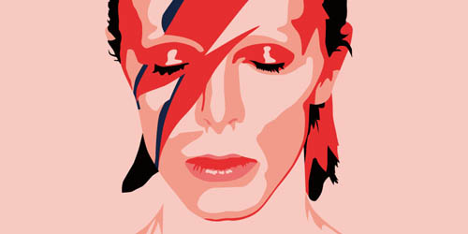
Glam Rock
Glam rock comes about because of Progressive Rock excess (musically)
Glam brings back simple songs and overstated dress
David Bowie almost single-handedly creates Glam Rock
Puts on theatrical concerts as his alter ego Ziggy Stardust
Rock concerts now become more about entertainment than inspiration
Other contributing groups: Alice Cooper, KISS, Gary Glitter
Elton John fits during this time frame - over the top glam
Never really catches on in the U.S. but Heavy Metal takes some elements from it

Slide 29
David Bowie -
“Space Oddity”

Slide 30
Elton John -
“Crocodile Rock”

Slide 31
Jazz Rock / Fusion
Jazz Influenced Rock
Jazz Rock/Fusion: Jazz groups playing rock
Roots in the late 60’s from work of Miles Davis
Bands use electric guitar, electric bass, electric piano and synthesizers
Remains the basis of “lite jazz” today
Important groups: Return to Forever, Weather Report, Pat Metheny Group, Herbie Hancock
Jazz Influenced Rock: Rock bands with a horn line (aka: Ska)
Important groups: Bill Chase, Chicago, Steely Dan, Blood Sweat & Tears

Slide 32
Chicago -
“25 or 6 to 4”

Slide 33
Blood, Sweat, and Tears - “Spinning Wheel”

Slide 34
Funk
Existed in 1950’s as an offshoot of mainstream jazz, but wasn’t called “funk” until James Brown gets big in the mid 60s
Genre never fully developed. Started getting popular but ran into a wall of Disco
Appears in several movies: Shaft (Isaac Hayes), Trouble Man (Marvin Gaye) and Superfly (Curtis Mayfield)
Focus on a fat bass sound, vocals are soulful
Important groups: James Brown (Godfather of Funk), Earth Wind and Fire, George Clinton & Parliament/Funkadelic, Sly & the Family Stone and the Isley Brothers

Slide 35
James Brown -
“I Feel Good”

Slide 36
Earth, Wind, and Fire -
“September”

Slide 37
Disco
In the early 70s, there were discos (discotheques) in Black, Latino & Gay communities
The creation of the 12” single LP instead of 7” allowed songs to be longer. People were a bit more creative
Saturday Night Fever movie (starring John Travolta) introduced the world to disco
Precursor to Techno & House music
Heavily synthesized, few guitars, simple beat
DJs (working at the discos) needed to make themselves stand out. They started mixing songs and cracking jokes - this leads to very early rap
Disco roots the majority of music in the 80s and 90s

Slide 38
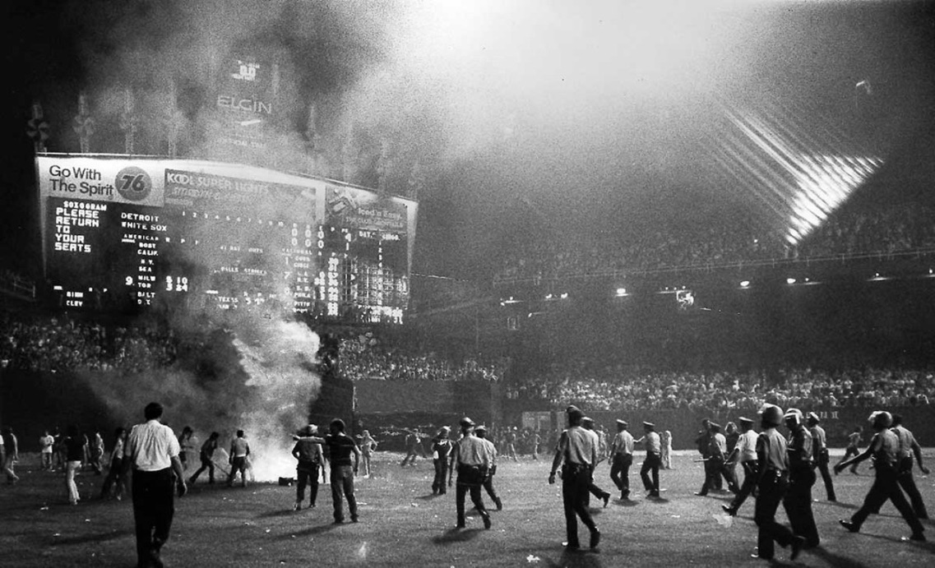
Disco Sucks Movement

Slide 39
Village People -
“YMCA”

Slide 40
Bee Gees -
“Stayin’ Alive”

Slide 41
Punk
Profound & disruptive to the music industry - rebellious
Remarkably simple music
All about high energy & attitude / going against the grain
Birthplace: CBGB(OMFUG) - Country, Bluegrass, Blues & Other Music for Uplifting Gormandizers - club in NYC
“DIY” attitude permeates all aspects of punk, from clothing to not knowing how to play the instruments
In US, punk is an attitude / fashion statement; in Britain it’s much more political

Slide 42
In Britain, the following factors lead to the rebellion that encourages punk music:
Discontent in country: unemployment, strikes, wage restraint, rioting
No opportunity for youth
Economics were terrible: high unemployment & high inflation
Youth see no future & have no hope
Starts as an underground rock scene in London - spoke out against other forms of music
US Punk Bands - The NY Dolls, The Ramones, The Talking Heads
British Punk Band - The Sex Pistols

Slide 43
The Ramones -
“Blitzkrieg Bop”

Slide 44
The Sex Pistols -
“G-d Save the Queen”

Slide 45
“G-d Save the Queen" lyrics
God save the queen
The fascist regime
They made you a moron
A potential H bomb
God save the queen
She's not a human being
and There's no future
And England's dreaming
Don't be told what you want
Don't be told what you need
There's no future
No future
No future for you
God save the queen
We mean it man
We love our queen
God saves
God save the queen
'Cause tourists are money
And our figurehead
Is not what she seems
Oh God save history
God save your mad parade
Oh Lord God have mercy
All crimes are paid
Oh when there's no future
How can there be sin
We're the flowers
In the dustbin
We're the poison
In your human machine
We're the future
Your future
God save the queen
We mean it man
We love our queen
God saves
God save the queen
We mean it man
There's no future
In England's dreaming God save the queen
No future
No future
No future for you
No future
No future
No future for me
No future
No future
No future for you

Slide 46
New Wave
Groups had the spirit of punk, but not the harshness or in your face style
Music and lyrics are more complex than pop music
Uses a lot of electronics (synthesizers)
Important Bands:
The Police - “Roxanne”, “Don’t Stand So Close To Me” (Rock & Roll Hall of Fame - 2003)
Elvis Costello - “Alison”, “Less Than Zero”
Blondie - “One Way Or Another” (Rock & Roll Hall of Fame - 2006)
Tom Petty - “American Girl”, “Refugee”, “Don’t Do Me Like That” (Rock & Roll Hall of Fame - 2002)

Slide 47
Blondie -
“One Way or Another”

Slide 48
The Police -
“Roxanne”

Slide 49
Tom Petty -
“American Girl”

Slide 50
Production Line Pop
“Motown of the 70s”
Name is based off the idea that groups are just put together to generate the same type of song
Bay City Rollers - the original boy band
Formed in 1970 - touted as the “new Beatles”. Promoted to a market of teenagers. 1st UK hit in 1971
Manager named the group by sticking a pin in a US map and hitting Bay City, Michigan
Inspired a genuine outbreak of teenage frenzy like “Beatlemania”
“Rollermania” spread briefly to the US in 1976
Also: David Cassidy (from Partridge Family); The Osmonds - created to combat the Jackson 5 (Motown)

Slide 51
Middle of the Road
“Grown-up music” - a lot of Rock is considered geared towards teens and 20 somethings. Middle of the Road encompasses the music geared towards the older generations
Often described as bland and forgettable music
Not technically a genre, more like a radio format
Included the genres: easy listening, pre-rock pop music
Artists: Neil Diamond, The Carpenters, Barbra Streisand, Burt Bacharach

Slide 52
Reggae
1st time country outside the US/UK makes a HUGE contribution to music
Started in late 60s, a rock-influenced form of music called “rocksteady” began to develop; it evolved into what is now known as reggae
Reggae emerged from Ska and American Rock and Roll
60s - Chris Blackwell (Studio One Label) began importing singles from Jamaica to specialist record shops in London.
Records the group Skatalites and early Bob Marley & the Wailers

Slide 53
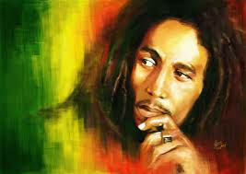
Bob Marley
Embodies the Rastafarian ideals
1st “Third World Superstar”
Considered a visionary, a revolutionary artist and a “Rasta Prophet”
Career stretched over 20 years, encompassing every aspect of Jamaican music from ska to contemporary reggae
1964 - founded “The Wailing Wailers” - 1st record Simmer Down established them as hottest group in Jamaica
Rastafarianism is at the core of Wailers’ music - very religious, God is found within every man, respect for nature, Rastafarians are the chosen people of God and are on earth to promote his power and peacefulness

Slide 54
1972 - Wailers sign to Island Records and were given the best recording facilities and treated like a rock group
Album Catch A Fire was the first reggae album to be professionally produced and promoted
1975 - Natty Dread album drops & European tour
1976 - Rastaman Vibration hits American charts
1976 - Bob Marley leaves Jamaica after a shooting that almost kills him
1980 - European tour - band breaks festival records for attendance; American tour opening for Stevie Wonder - play two shows and Marley is diagnosed with cancer.
April 1981 - Marley is awarded Jamaica’s Order of Merit in recognition for outstanding contribution to the country’s culture
May 11, 1981 - Marley dies in Miami at age 36
May 23rd - given official funeral in Jamaica - attended by the Prime Minister
1994 - Inducted into the Rock and Roll Hall of Fame

Slide 55
Bob Marley -
“Three Little Birds”

Slide 56
Hard Rock

Slide 57
Heavy Metal Facts
-Guitar riffs - weapon of choice;
- Dark/violent lyrics screamed by male singer considered attack to mainstream pop & yuppie culture

Slide 58
Black Sabbath -
“War Pigs”

Slide 59
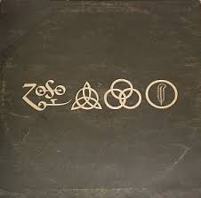
Led Zeppelin -
“Led Zeppelin IV”

Slide 60
ACDC -
“Highway to Hell”

Slide 61
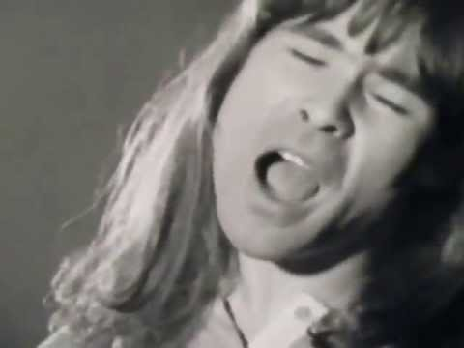
Ian Gillan
Lead Singer - Deep Purple

Slide 62
Mainstream -or- Adult Oriented Rock (A.O.R.)
FM Radio station designation, implied Adults likely to buy albums instead of singles
sort of a “catch all”
The Eagles, Billy Joel, Elton John, Carlos Santana, Fleetwood Mac, REO Speedwagon, Paul McCartney & Wings, Peter Frampton, Journey, Supertramp

